Slide 1
PulseRF: Physics-Augmented ML Modeling and Synthesis for High-Frequency RFIC Design
Hyunsu Chae, Hao Yu, Sensen Li, and David Z. Pan
ECE Department, The University of Texas at Austin

Slide 2
Outline
Motivation
Problem Formulation
PulseRF Framework
Experimental Results
Summary

Slide 3
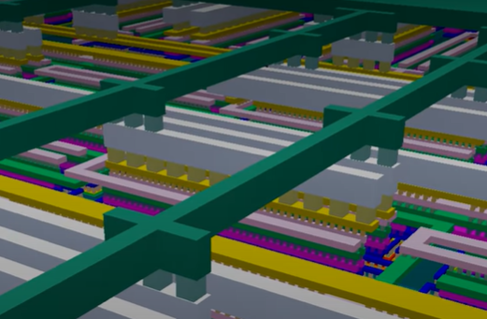
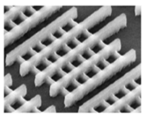
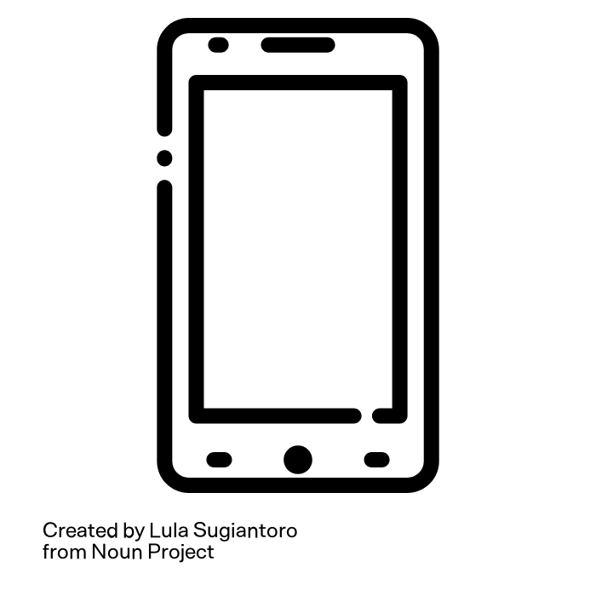



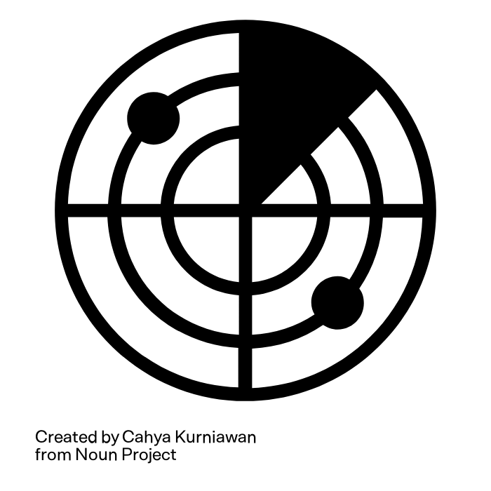
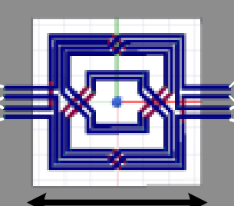
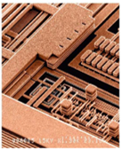
RFIC (Radio Frequency Integrated Circuit)
RFIC components are fundamental in wireless systems
RFIC = active + passive components
Active Components
Passive Components
[Behzad Razavi, RF Microelectronics]
Motivation

Slide 4
RFIC Passive Design Challenges
The majority of RFIC design efforts are focused on passive design and optimization
Occupy most of core chip area
Need to balance many different design objectives
Minimize loss
Maximize bandwidth
Address impedance transformation and mismatch, ..
Have multiple functions
Facilitate facilitating output, inter-stage, and input matching
Filtering
Phase-shifting, ..
Motivation

Slide 5
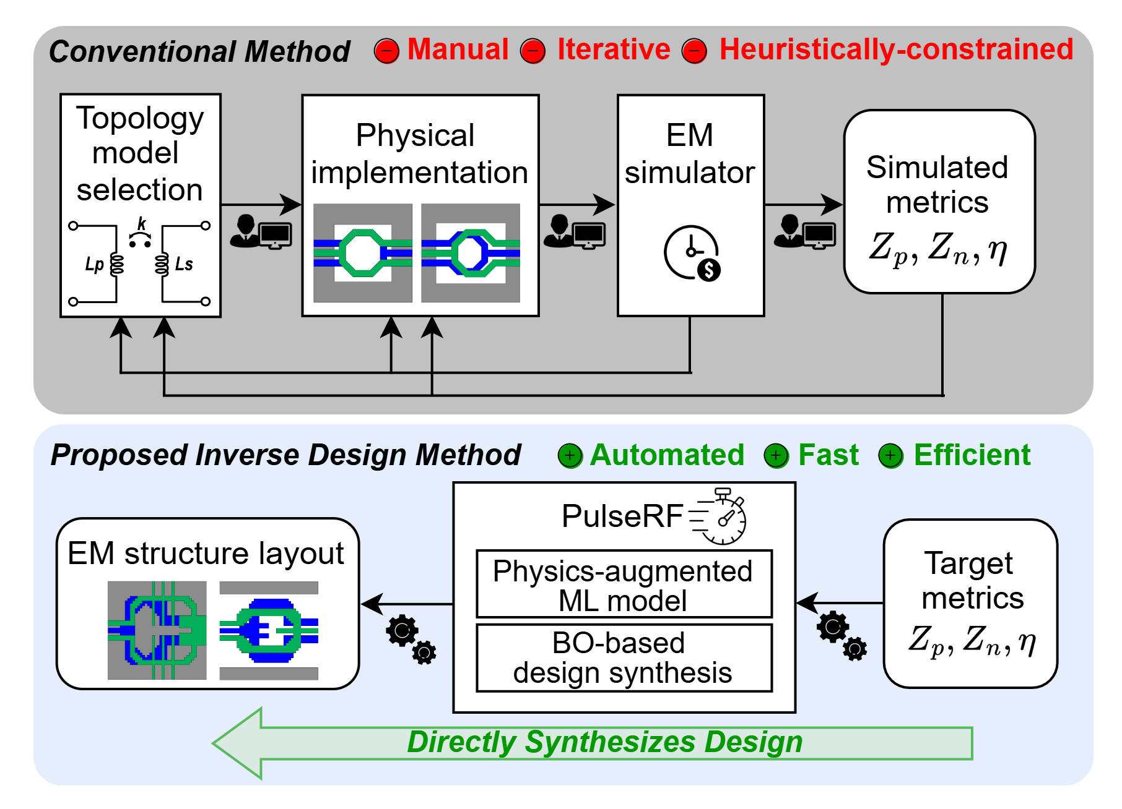


RFIC Passive Design Challenges
More general definition of design space
Physics-augmented ML model for fast design evaluation
Bayesian optimization-based design synthesis for efficient exploration of design space
Optimization is confined to a limited set of topology templates
Slow simulation restricts the number of optimization iterations possible
Motivation

Slide 6
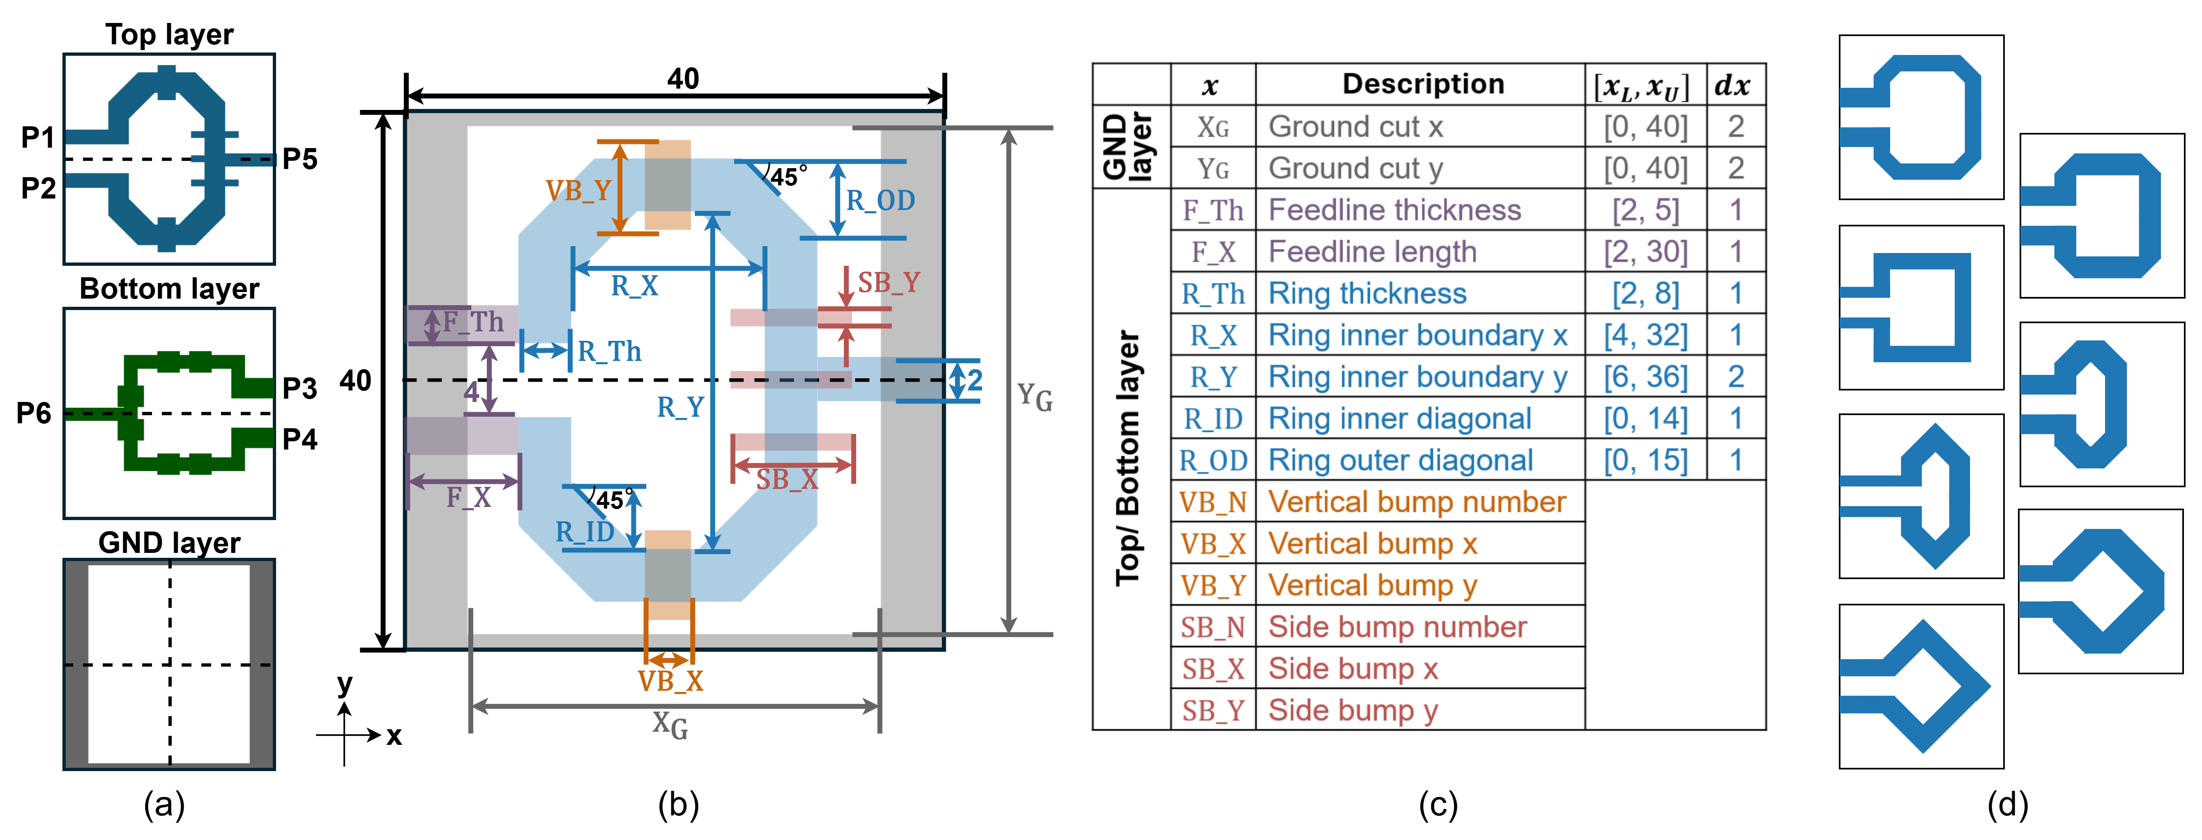
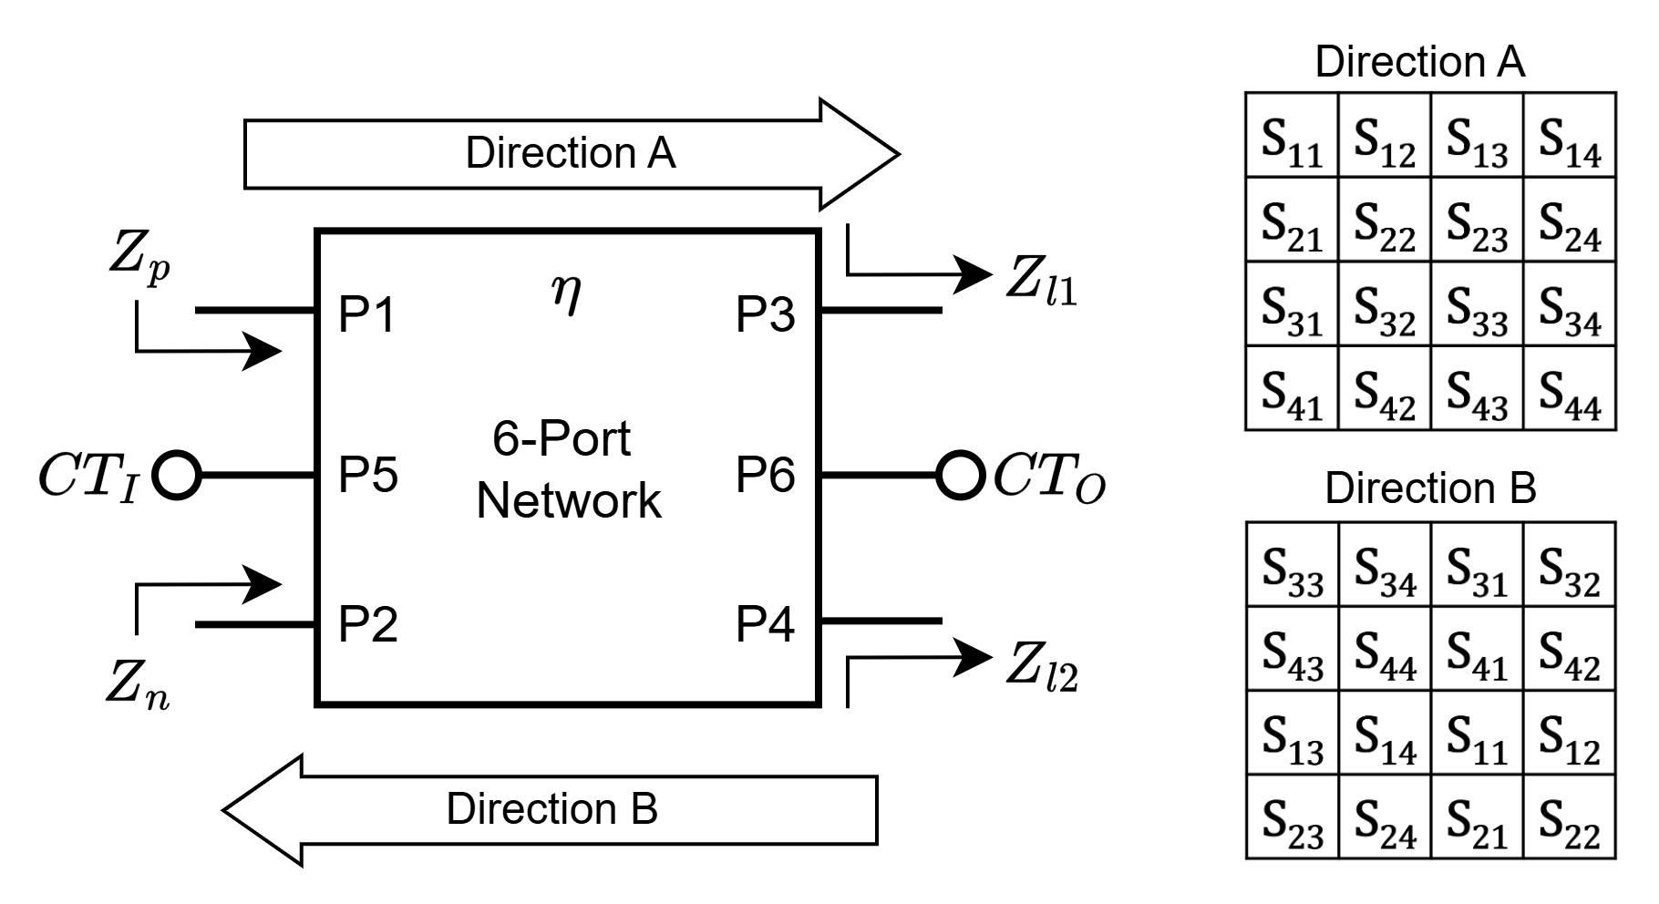
PulseRF Problem Formulation
Low Loss Impedance Transformation
The major function of RF passive networks is to achieve impedance transformation with minimal loss
Problem Formulation

Slide 7
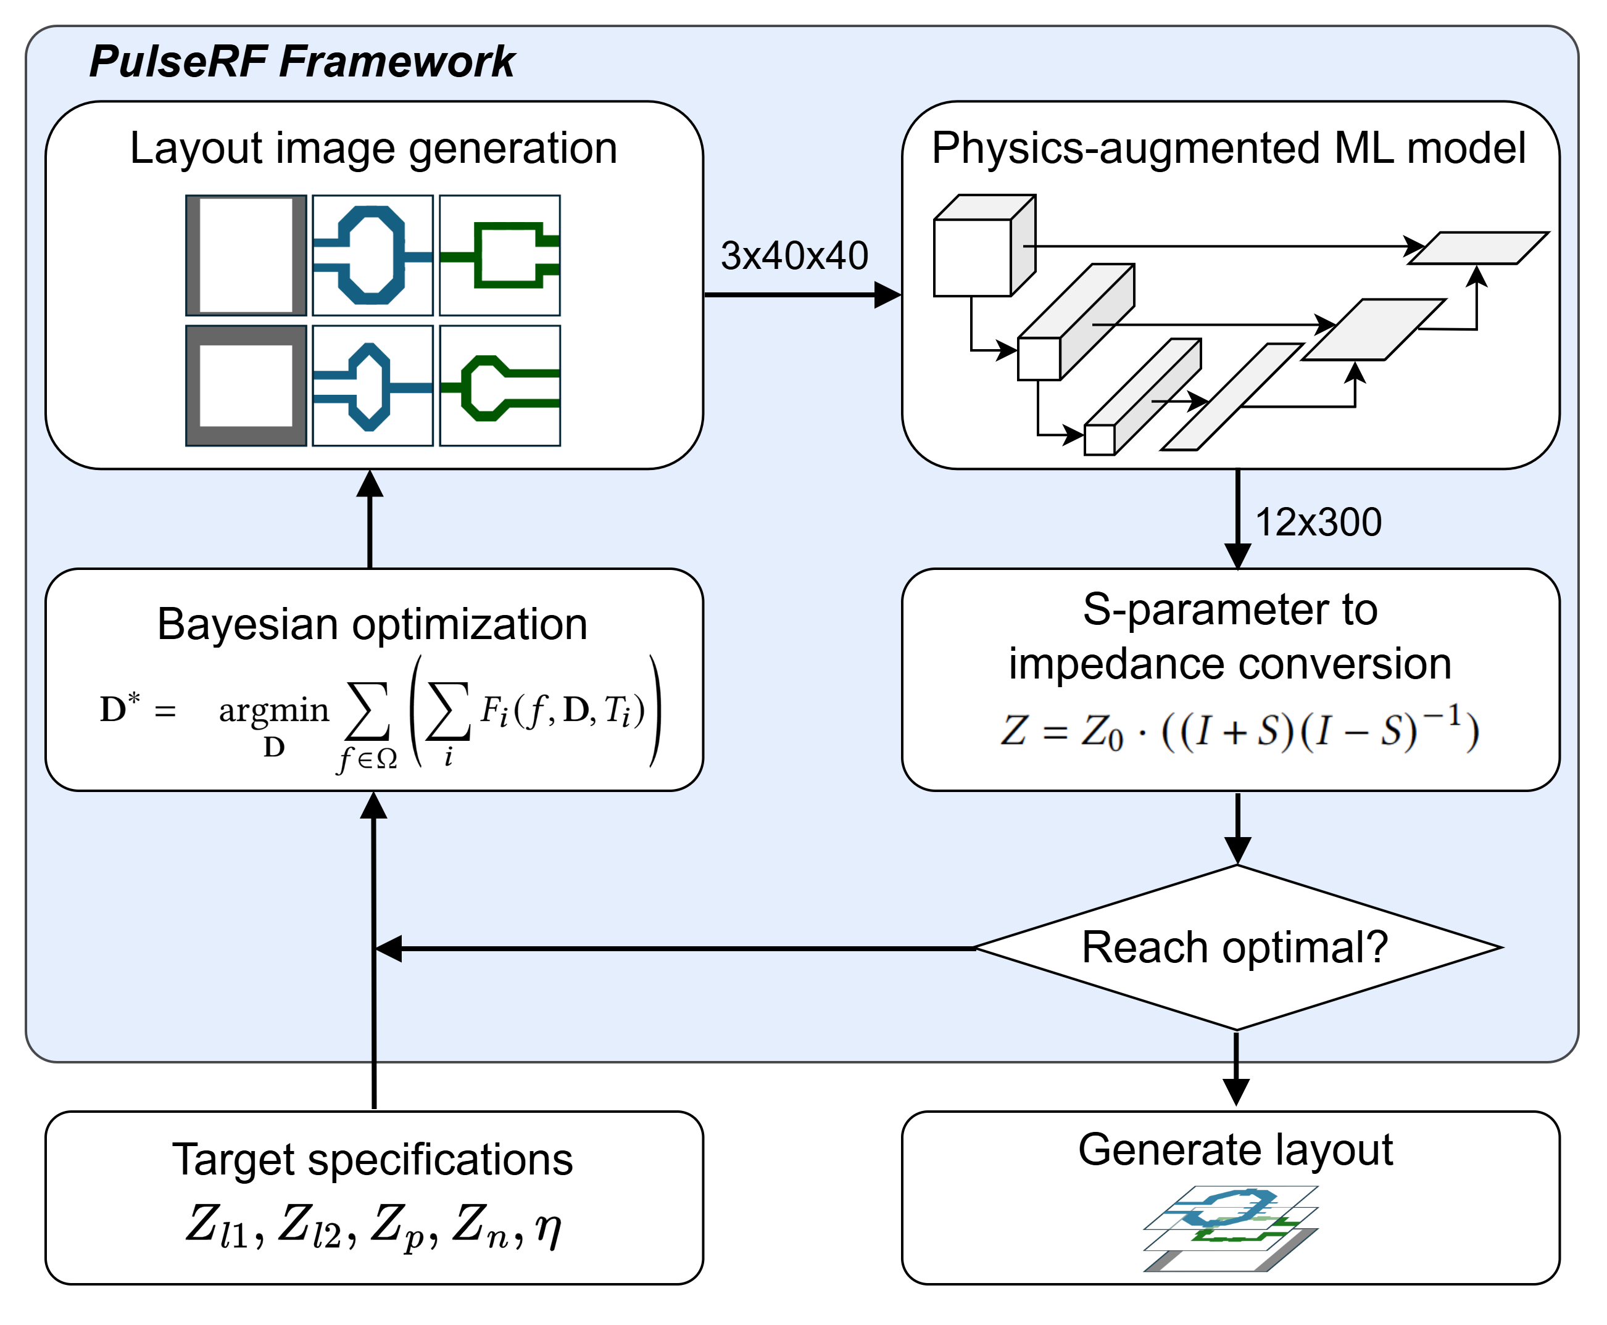
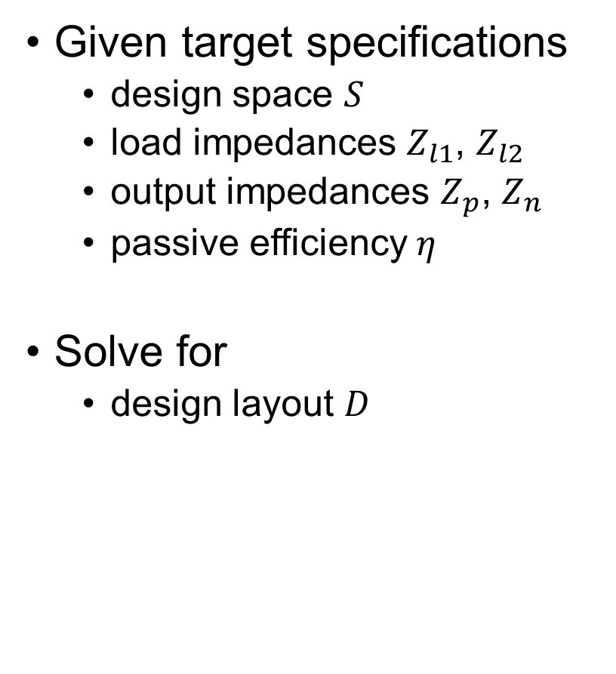

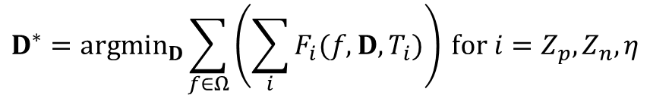
PulseRF Problem Formulation
Given target specifications
design space $S$
load impedances $Z_{l1}$, $Z_{l2}$
output impedances $Z_{p}$, $Z_{n}$
passive efficiency $η$
Solve for
design layout $D$
$$D^{∗}={argmin}_{D}\sum_{f∈Ω}{\left(\sum_{i}{F_{i}(f, D, T_{i})}\right)} for i=Z_{p}, Z_{n}, η$$
$$subject to D∈S$$
Problem Formulation

Slide 8
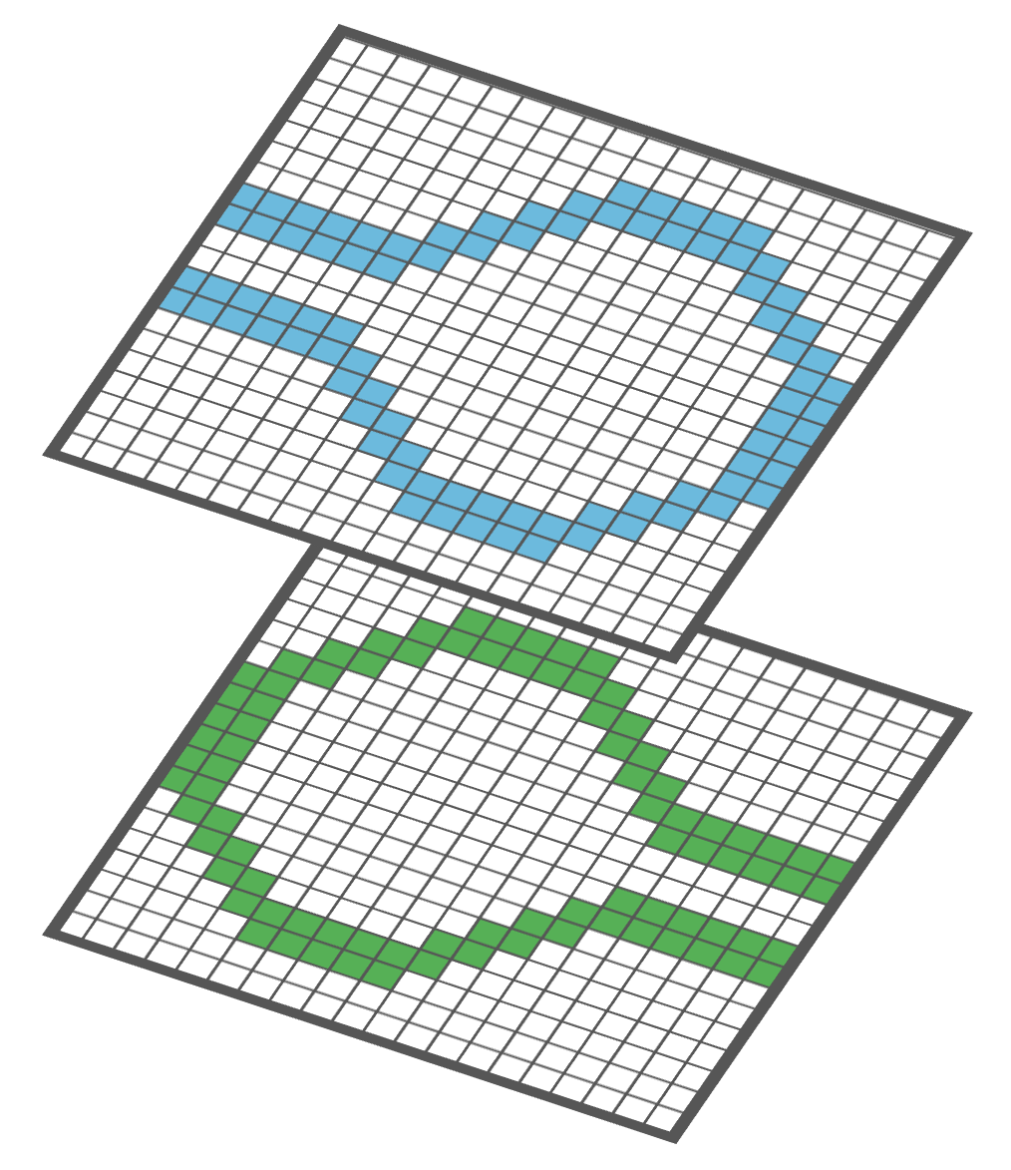
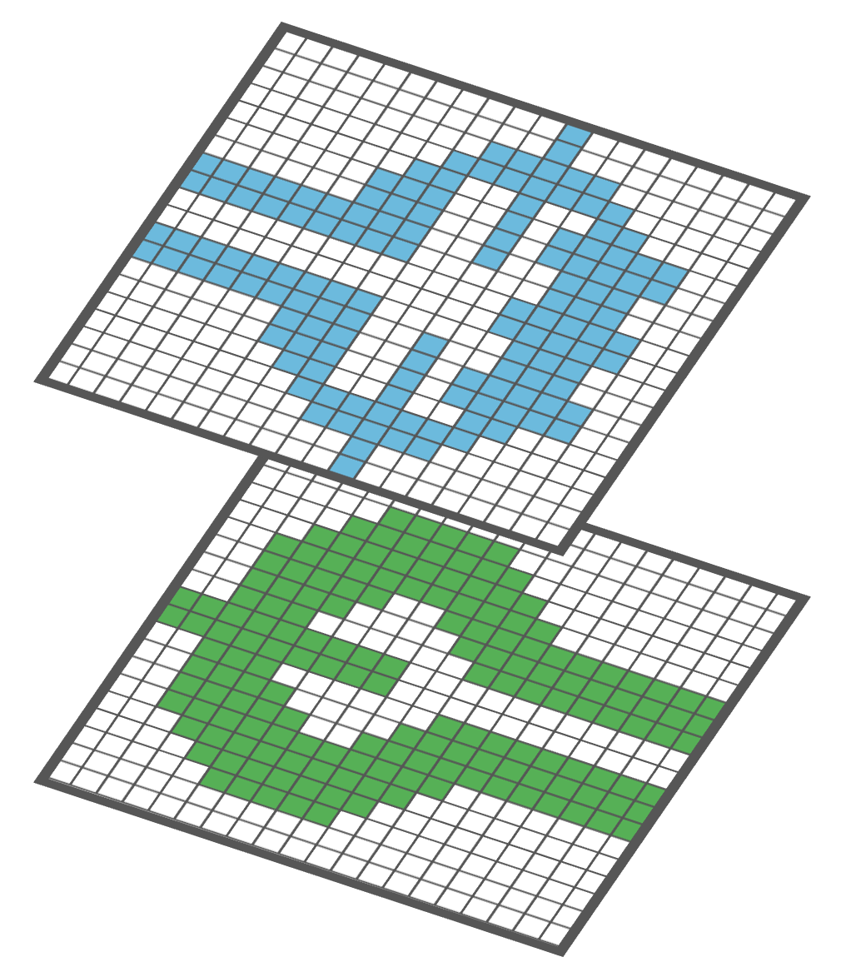
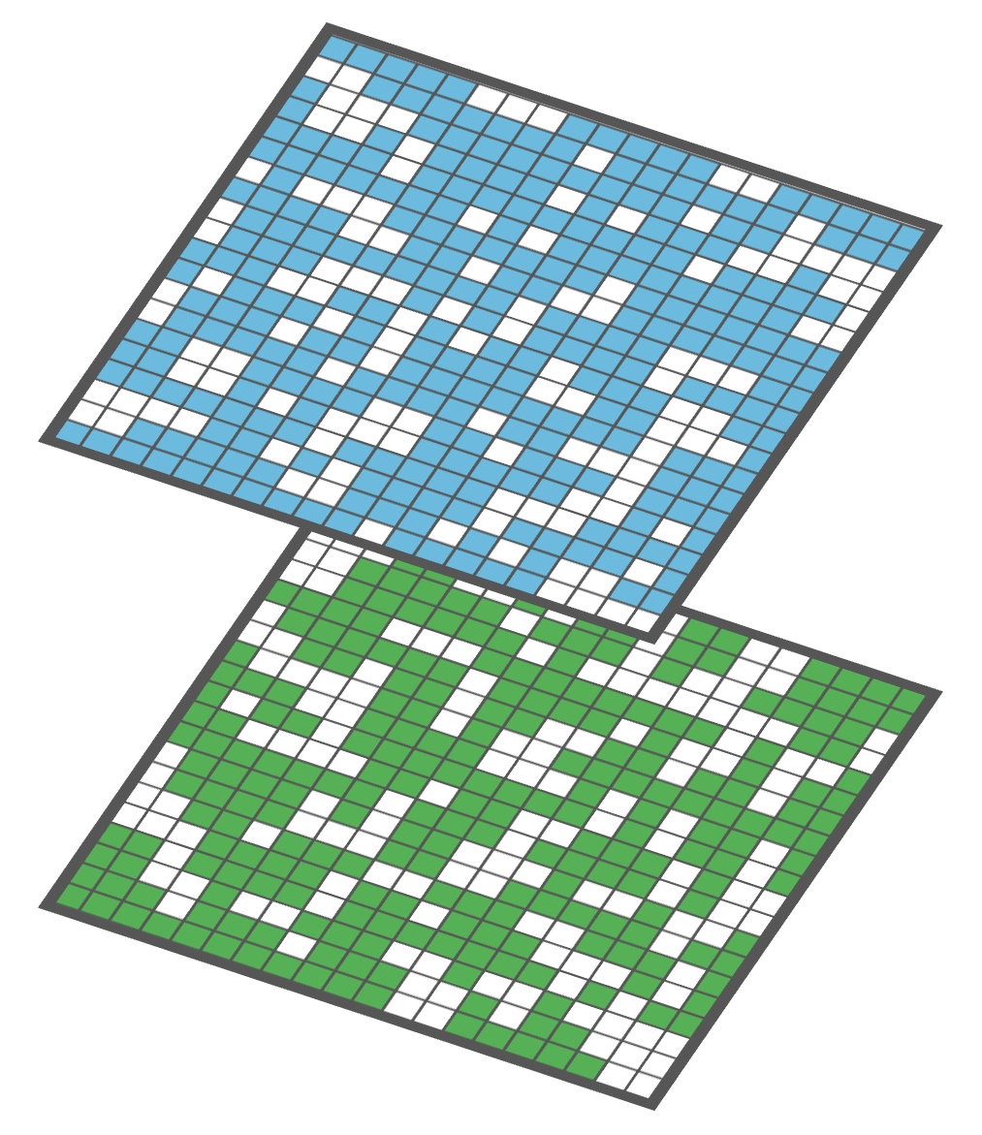
1) Design Space Formulation
Why do we need good design space?
Conventional approach : highly-restricted, few design choices
Pixelated approach : randomly scattered pixels and isolated shapes lead to redundant design performance [1][2]
Meaningful designs and not too restricted design space
Conventional
Template-based
Complete
Pixelated
PulseRF
[1] E. A. Karahan, Z. Liu and K. Sengupta, "Deep-Learning-Based Inverse-Designed Millimeter-Wave Passives and Power Amplifiers," JSSC 2023
[2] J. Lee, W. Jia, B. S. -. Rodriguez and J. S. Walling, "Pixelated RF: Random Metasurface Based Electromagnetic Filters," NEWCAS 2023
PulseRF Methods

Slide 9
1) Design Space Formulation
⇨ PulseRF: Flexible template-based approach with local deformations
40x40 grid (120 um x 120um), multiple layers, ring structure
28 parameters
Diverse ring shapes
Local deformations
PulseRF Methods

Slide 10
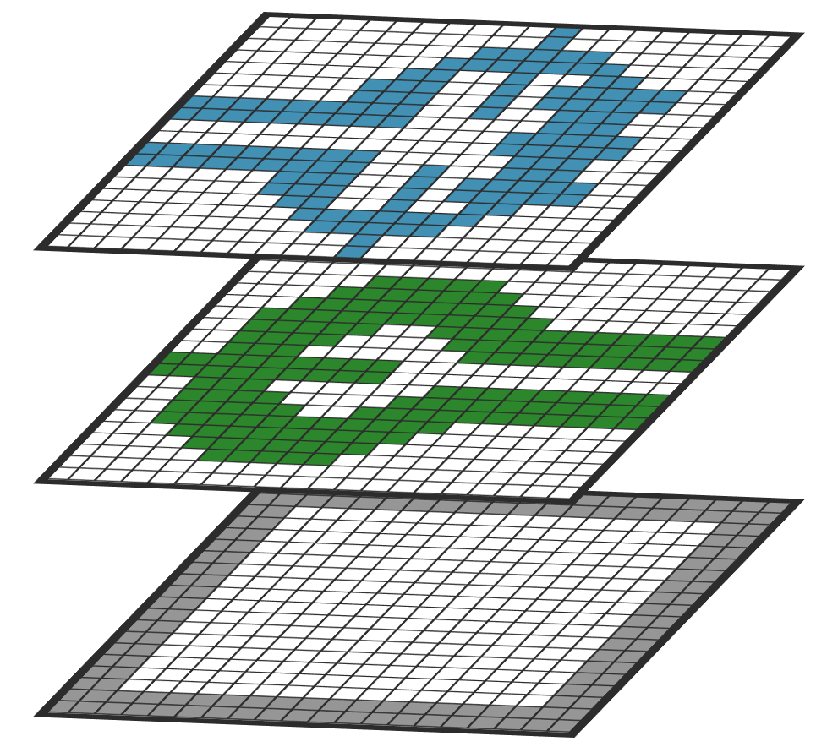
2) ML Surrogate Model
Why do we need surrogate ML model?
Fast evaluation of design (EM simulation is slow) in optimization flow
The model can be repeatedly used to address various design goals in RF passive design
Layout Image
S-parameters
ML Surrogate
Model
 | S11 | S12 | S13 | S14 | S33 | S34
1
2
…
300
PulseRF Methods

Slide 11
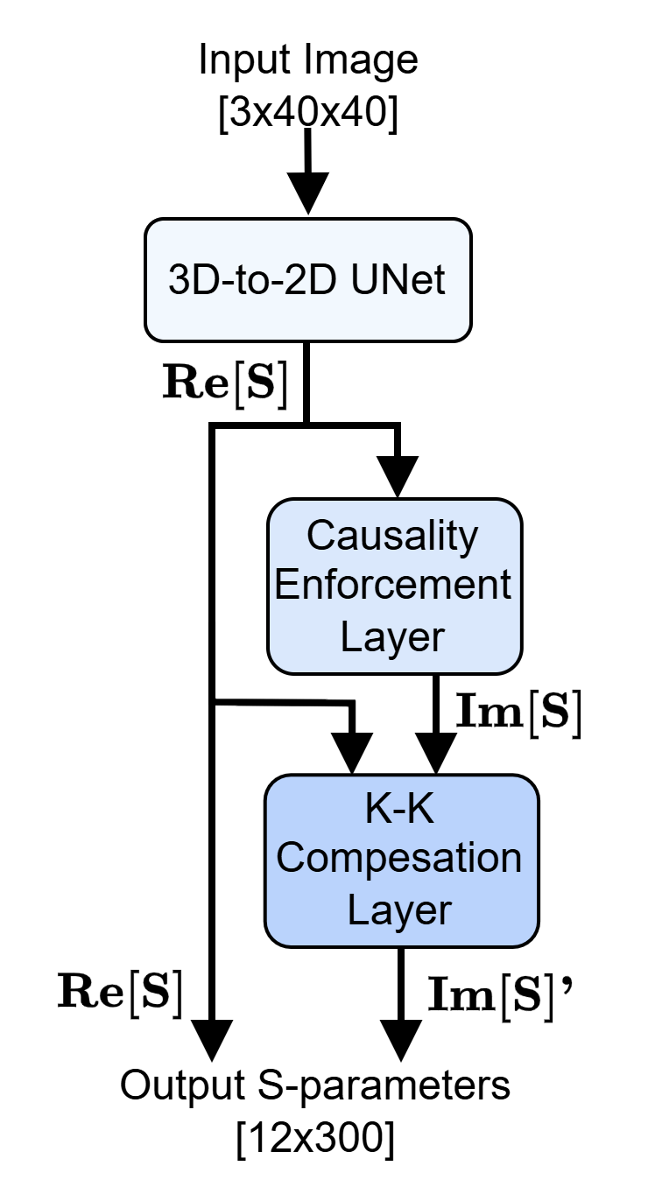
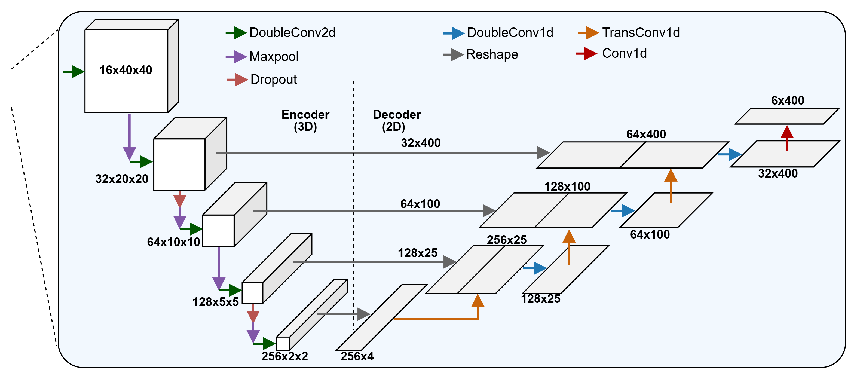
2) ML Surrogate Model
3D-to-2D UNet
Similar input/output dimension
Able to capture both localized and contextual features
Adapt UNet to handle 3D (image)-to-2D (S-parameters)
PulseRF Methods

Slide 12
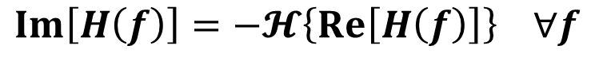
2) ML Surrogate Model
Enforce physics into the model
Causality enforcement layer (CEL) [3]
Utilizing the enate relationship of real and imaginary parts of S-parameters
Kramer-Kronig compensation layer (KKCL)
Alleviate the discretization error at higher frequency range
$$Im\left[H\left(f\right)\right]=−𝓗\left\{Re\left[H\left(f\right)\right]\right\} ∀f$$
$$Im{\left[S_{k}\right]}^{′}=Im\left[S_{k}\right]+{linear}_{k}\{Re\left[S_{k}\right]\}$$
[3] Hakki Mert Torun et al, Causal and passive parameterization of s-parameters using neural networks, MTT 2020.
PulseRF Methods

Slide 13
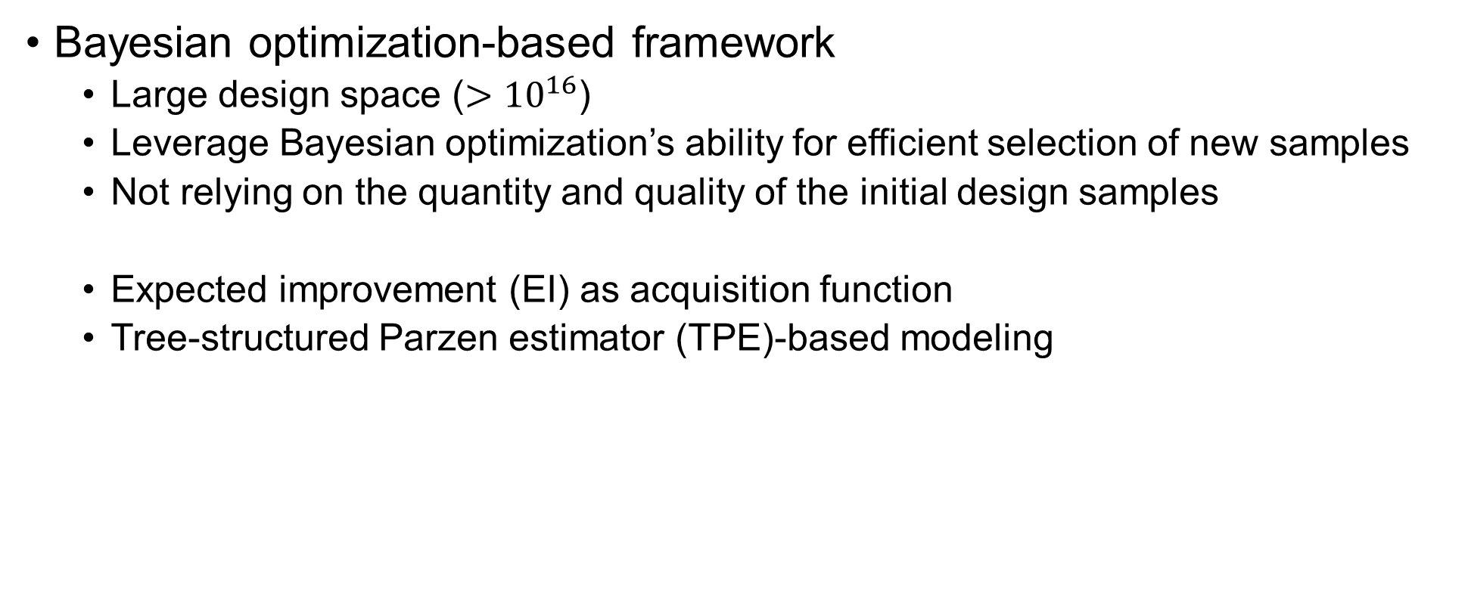
3) Inverse Design
Bayesian optimization-based framework
Large design space ($>{10}^{16}$)
Leverage Bayesian optimization’s ability for efficient selection of new samples
Not relying on the quantity and quality of the initial design samples
Expected improvement (EI) as acquisition function
Tree-structured Parzen estimator (TPE)-based modeling
PulseRF Methods

Slide 14

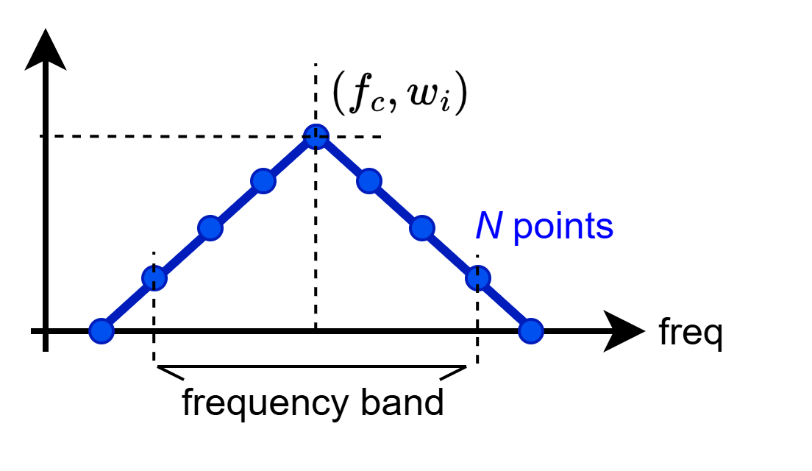
3) Inverse Design
Considering local deformation as noise in the optimization
Instead of considering them as design parameters
Cost function
Weighted sum of each objective with frequency weight
PulseRF Methods

Slide 15
Evaluation of ML Surrogate Model
R2 score
(Bigger the better)
MSE_f
(Smaller the better)
NMSE_f
(Smaller the better)
STCNN+CEL [3]
CNN+CEL
UNet+CEL
Proposed (UNet+CEL+KKCL)
ML model reduces design evaluation time to milliseconds
15
Results

Slide 16
Evaluation of Inverse Design Method
Experimental setting: reflect practical design requirements
Differential-to-differential (D-D) transformation
Single-ended-to-differential(SE-D) transformation
Each with (real→real, complex→real, complex→complex) tasks
HFSS simulation (High-Frequency Structure Simulator)
Teledyne InP 250nm HBT
Results

Slide 17
Evaluation of Inverse Design Method
Comparison for genetic algorithm vs PulseRF (BO-based)
GA
PulseRF
Observe the effect of local deformation (bumps)
PulseRF
without deformations
PulseRF
with deformations
Results

Slide 18
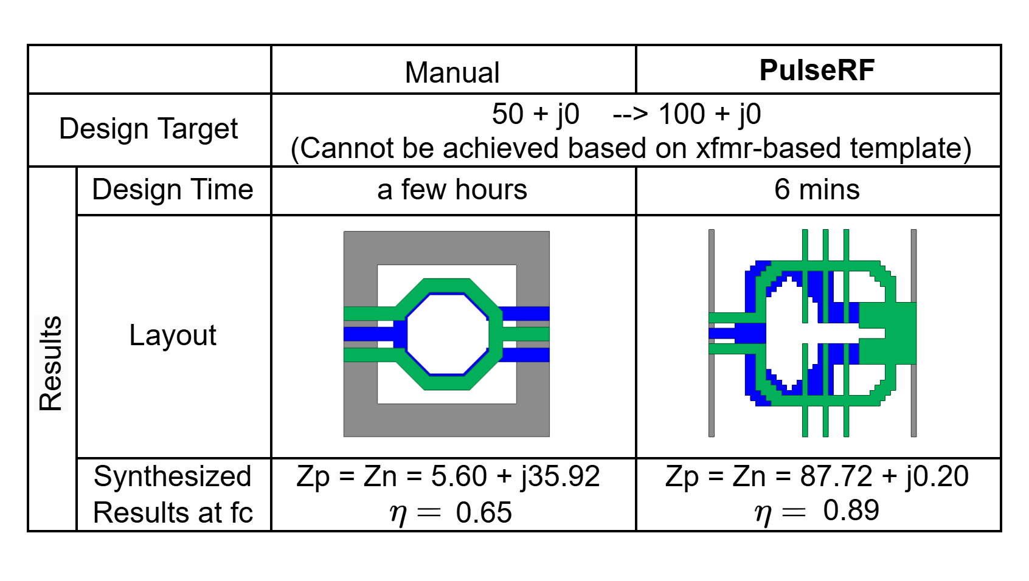
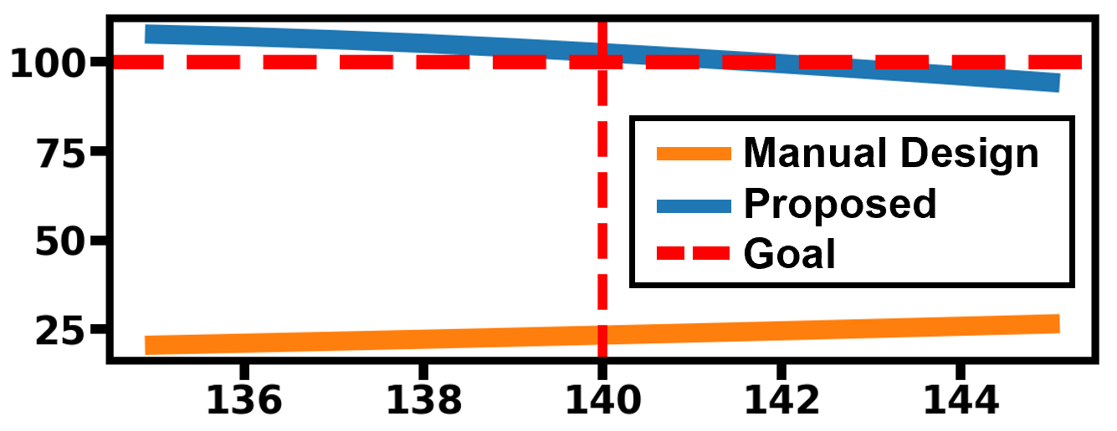
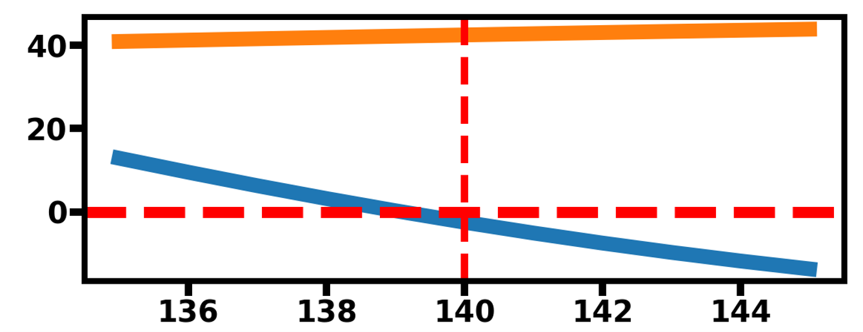
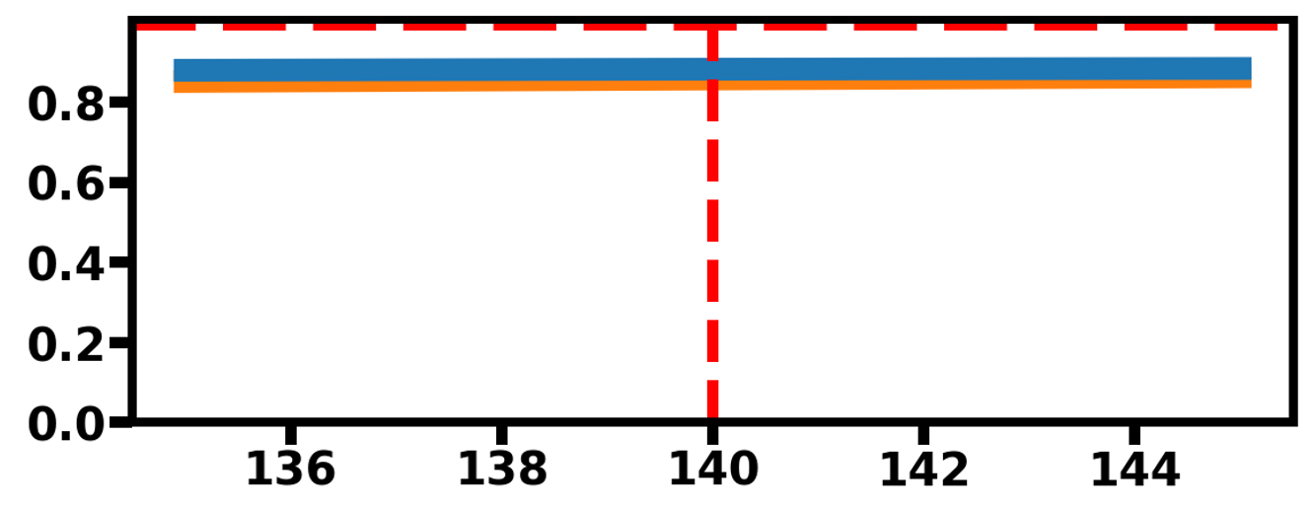

Comparison with Expert Manual Design
PulseRF
Speed-up
Better performance
Non-intuitive and incomprehensible design
Re[Zp] = Re[Zn]
Im[Zp] = Im[Zn]
$$η$$
Results

Slide 19
Summary
PulseRF framework:
Provides ML-assisted tool for automating RF passive design synthesis for generic multi-layer, multi-port structures
Utilizes the physics-augmented ML model that accurately predicts S-parameter up to 300GHz
Achieves faster, high-quality designs that is not intuitive by human
Summary

Slide 20
Thank You!

